Slide 1
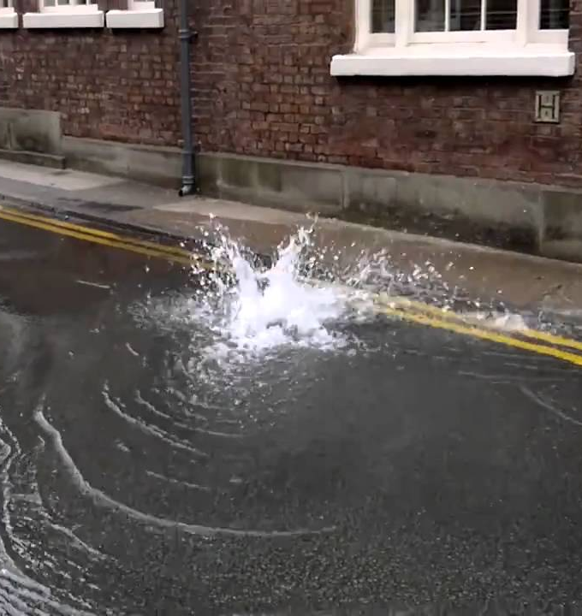
C
omplaint hainLK
- Centralized public complaint platform -
Group – 31
Cohndse242-041
Cohndse242-042

Slide 2
Market Opportunity
The Problem
No easily accessible platform for complaining public service-related problems such as water, electricity, road damages and garbage disposal to high authorities.
Long delays in solving issues of public due to manual process. Even the manual systems let public to submit the complaint, most of the time there is no way to track the status or communicate easily with the administrations.
No transparency between authority and public.
Market demand
Sri Lanka's Government policies are currently focusing on citizen engagement and e-solutions when taking measures to develop the country.
Campaigns such as clean Sri Lanka can make efficient and productive using platforms such as Complaint ChainLK.
Sri Lankas internet users are rising up to 15+ million with the increase in smartphone penetration.

Slide 3
Solution
We introduce
Complaint ChainLK
A web based complaint management system
Where it offers,
A platform for submit citizen complaints for relevant departments, authorities based on the location, category and priority. And they have the ability to review and read the services as well
It also supports the authority to receive and update the status of the complaint resolution which is also transparent to complainant (only the legally approved information) and relevant authorities.

Slide 4
Why Us?
Without us
No transparency and delay in communication between authority and citizens on public complaints.
Public problems are ignored and not prioritized due to lack of citizen involvements.
Some rural areas excluded due to less involvement and lack of identification.
No platform to raise public concerns
Unawareness of response authorities by the citizens.
With us
Any citizen can easily submit the complaint with the relevant location and images from anywhere anytime
Platform to speak up public concerns to the authority in a short period of time.
Ability to view the progress on the submitted complaints real time and comment on it.
Transparency builds the trust and bridges
the gap in between authorities and general
public.
Enhances the awareness of the public

Slide 5
Features
For Citizens
Web-based complaint submission.
A profile for each user.
Allow to choose tag the location of the problem related area (able to pin the location of problem exactly on a map).
Allow to upload pictures of the related complaint and the system uses AI to analyze the images and auto identify the possible issue and tag it (Ex:- Water Leakage).
The complaint is auto prioritized based on the severity, urgency, and type by the system.
Users can track the status of complaint through a two way information flow, receive real time updates and comment on the progress.
Can Choose whether the complaint should remain public or private in order to collaborate it with other users where they also can add comments.
For Authority
A powerful dashboard to filter complaints by location, category, priority.
AI assisted routing directly passes the complaints to correct department and officers.
Ability to update the progress of the complaint by only allowing legally ethical information to be transparent to the citizen.
Performance analytics.
Unresolved problems are directly sent to higher authorities.
Ability to generate reports based on analytics.

Slide 6
Technology Stack
Frontend: React.js, Tailwind CSS, Leaflet.js + OpenStreetMap, React Dropzone / FileReader API
Backend: Node.js + Express.js, Firebase Firestore, Firebase Auth, Firebase Storage, JWT + Middleware, Firebase Cloud Functions
AI / ML / CV: Hugging Face Transformers, Teachable Machine, OpenAI Whisper, Custom Rule-Based Routing
Geolocation: Leaflet.js + OpenStreetMap, Nominatim (OpenStreetMap Reverse Geocoding)
Notifications: Firebase Cloud Messaging, EmailJS
Chatbot: Rasa (Self-hosted)
Analytics: Metabase (Self-hosted), Google Looker Studio
Reports: jsPDF
Hosting & Deployment: Netlify, Vercel, Firebase Hosting
DevOps & Security: GitHub, GitHub Actions, Sentry, JWT + Middleware

Slide 7
Thank You!
Further questions please contact us
Cohndse242f-041@student.nibm.lk
Cohndse242f-042@student.nibm.lk

